Slide 1
Rigid Impacts
Week 4

Slide 2
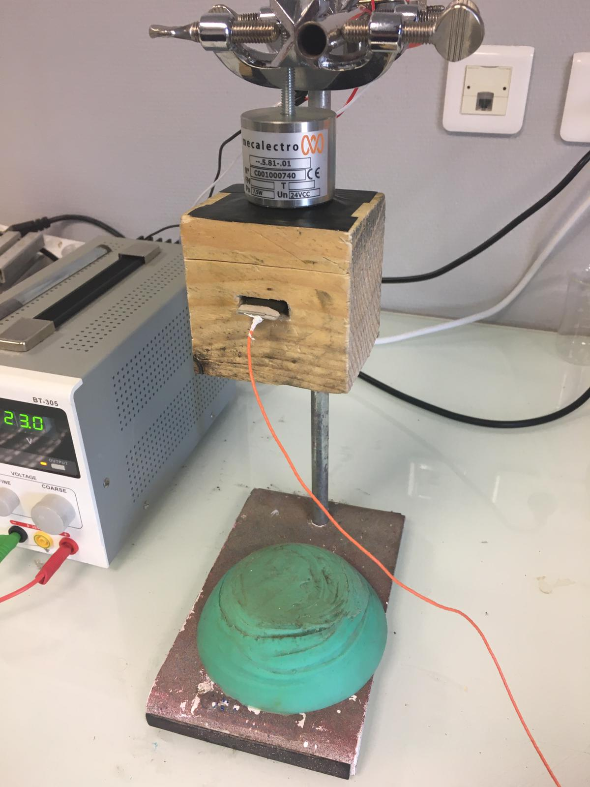
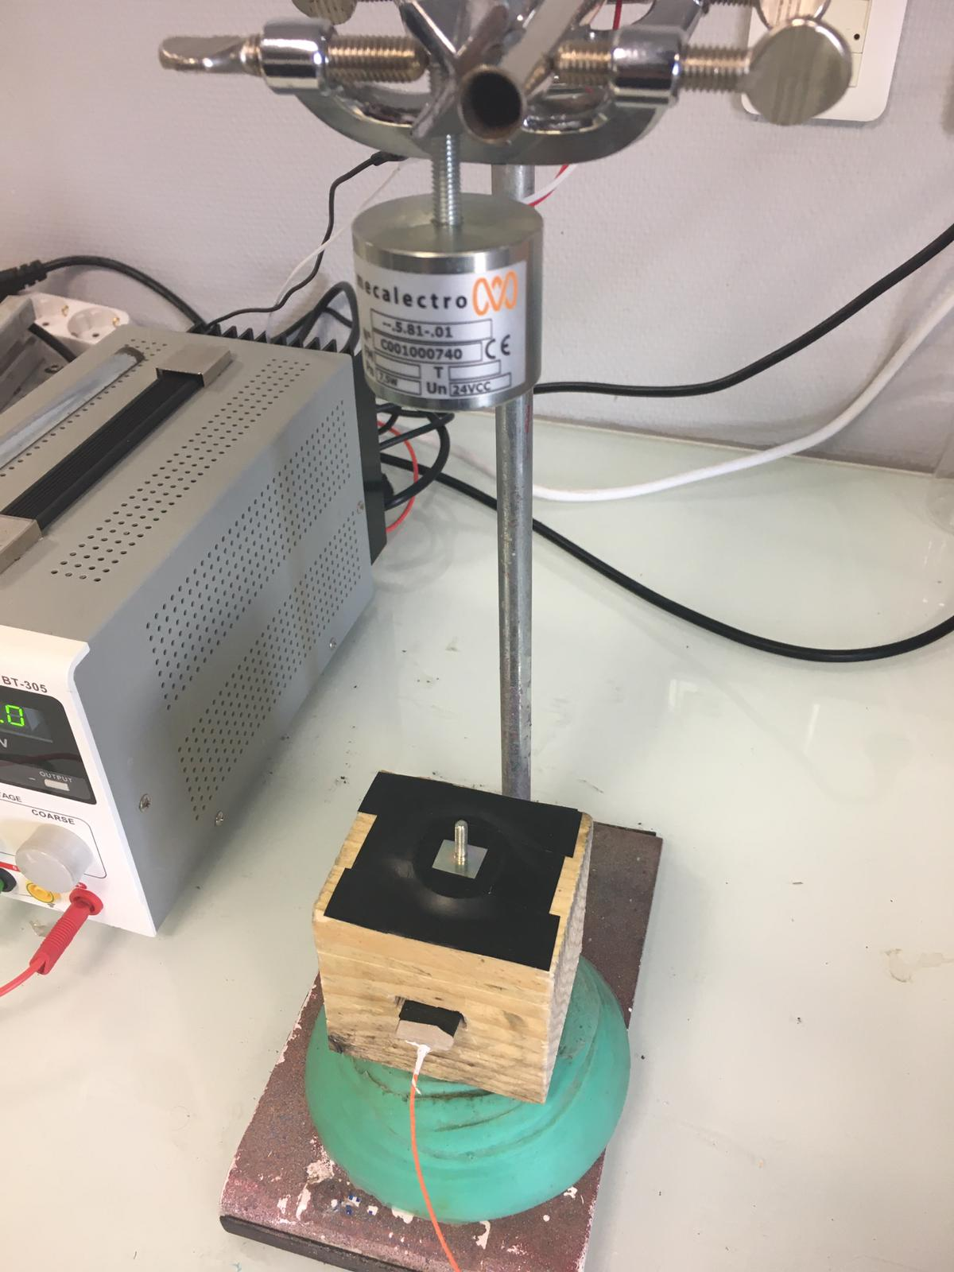
Impacts on a block of wood
Electromagnet
Accelerometer
Damper

Slide 3
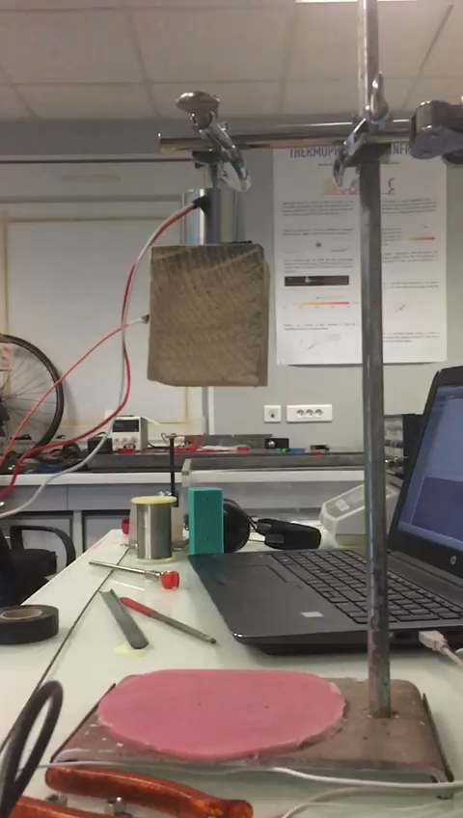
Impacts on a block of wood

Slide 4
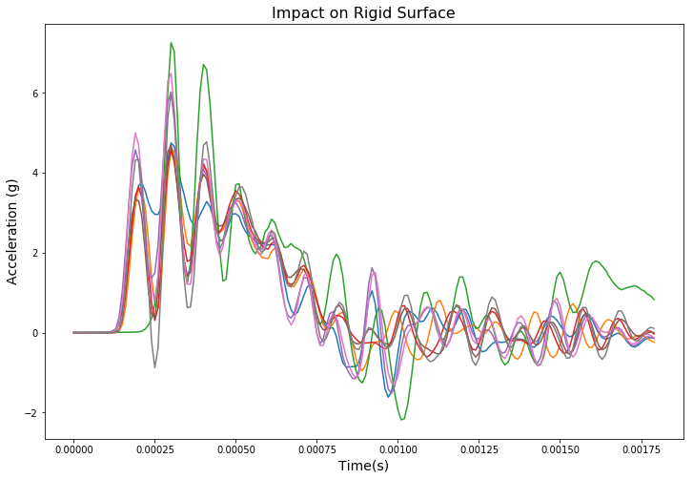
Understanding Repeatability

Slide 5
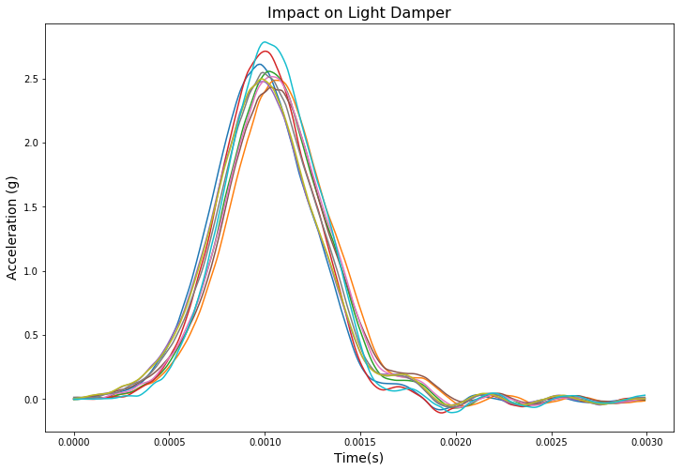
Understanding Repeatability

Slide 6
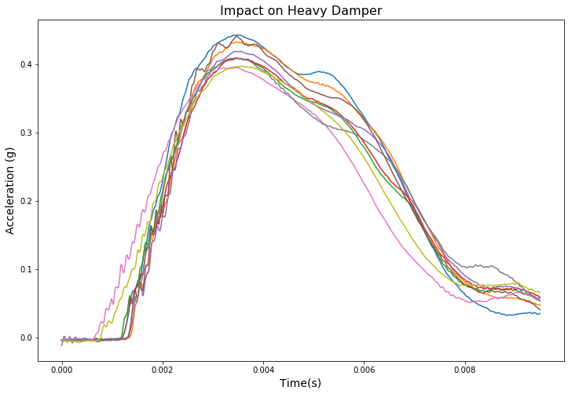
Understanding Repeatability

Slide 7
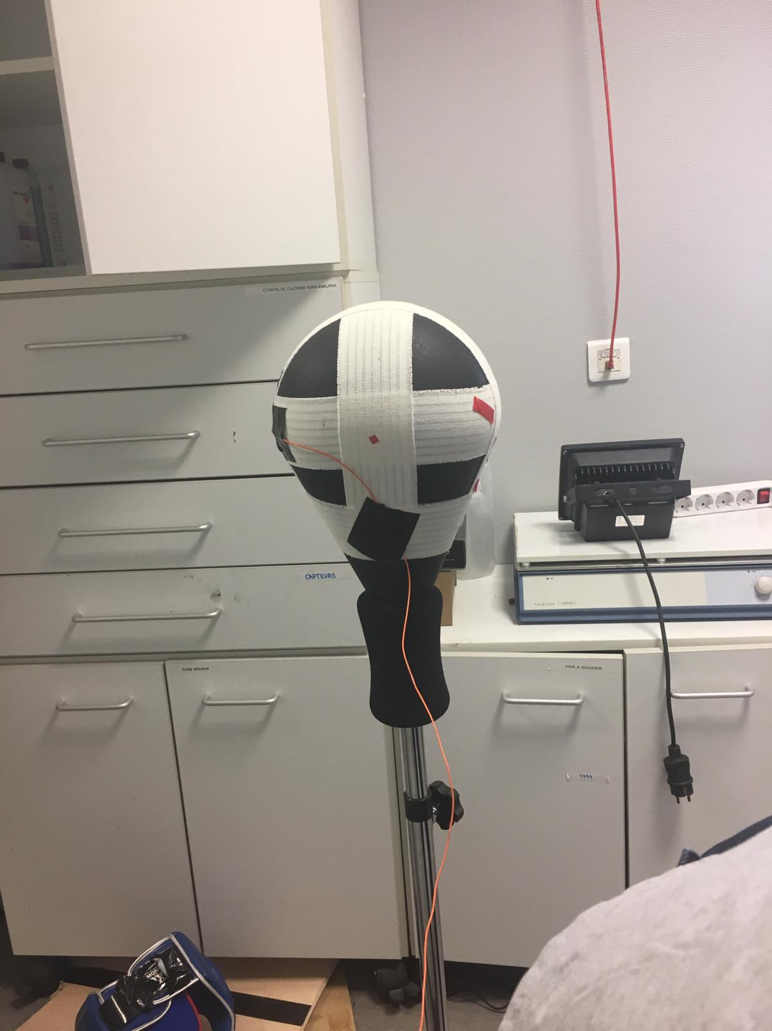
Back to the punching ball
Accelero 1 – On Foam
Accelero 2 – On Metal

Slide 8
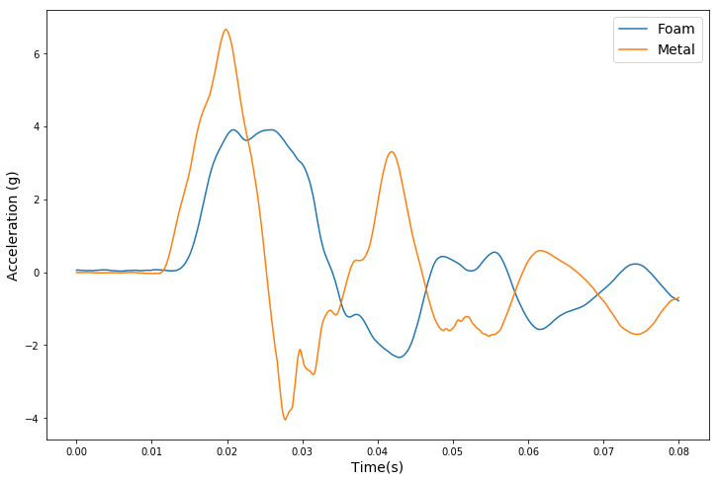
Impact on rigid section
Impact

Slide 9
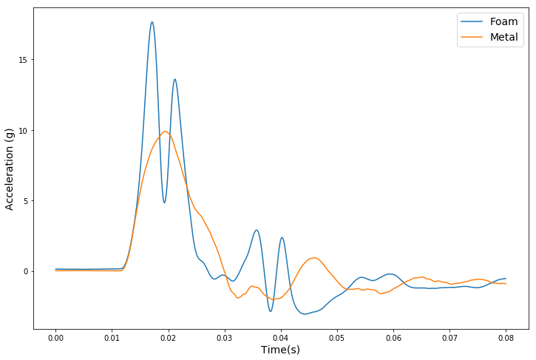
Impact on soft section (rigid)
Impact

Slide 10
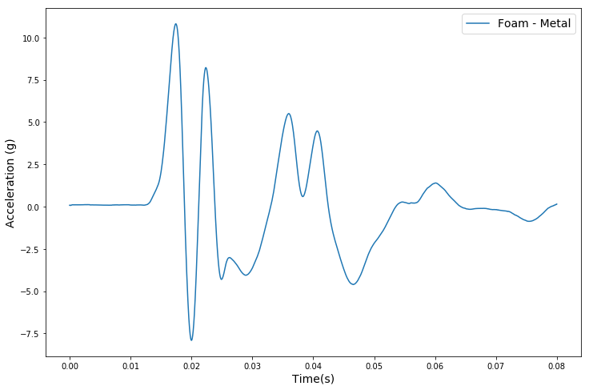
Relative motion of Foam
Graph of difference between acceleration of foam and acceleration of metal.

Slide 11



Relative motion of Foam
Graph of difference between acceleration of foam and acceleration of metal.
$$t_{1}$$
$$t_{2}$$
$$t_{1}$$

Slide 12
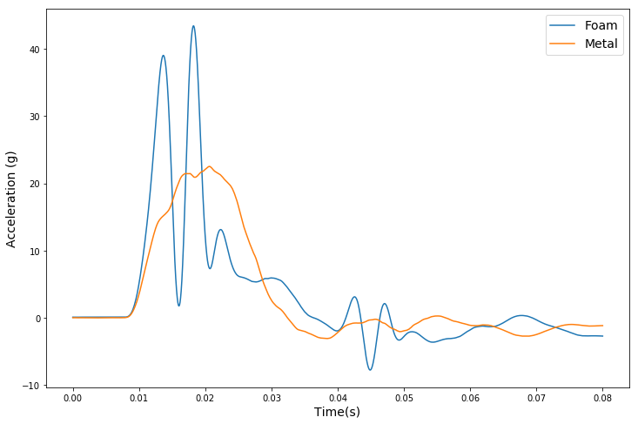
Impact on soft section (soft)
Impact

Slide 13
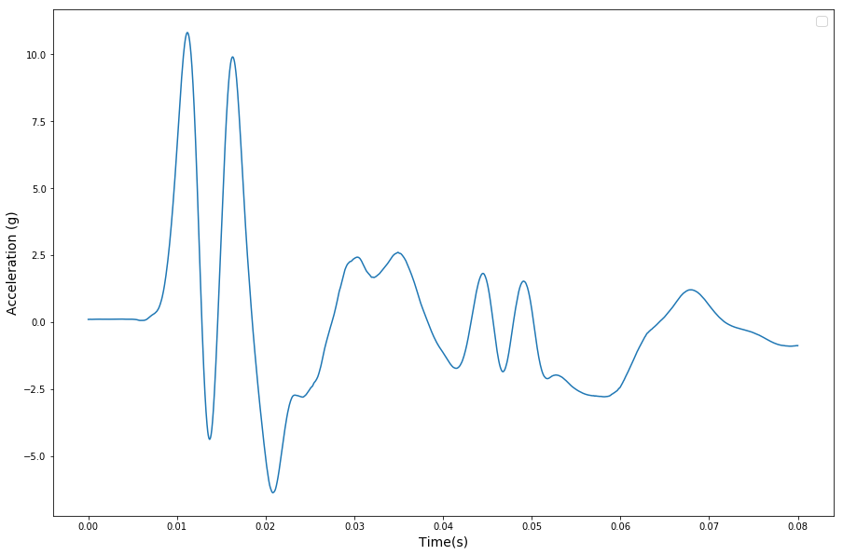
Relative motion of Foam
Graph of difference between acceleration of foam and acceleration of metal.

Slide 14




Relative motion of Foam
Graph of difference between acceleration of foam and acceleration of metal.
$$t_{1}$$
$$t_{2}$$
$$t_{1}$$
$$t_{1}$$

